Slide 1
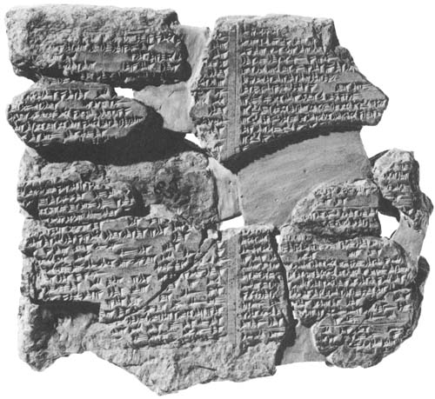
Epic of Gilgamesh

Slide 2
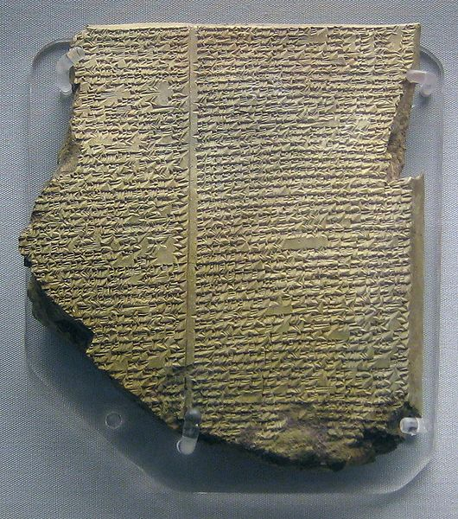
Cuneiform
Sumerian Writing
Scribes - Writers

Slide 3
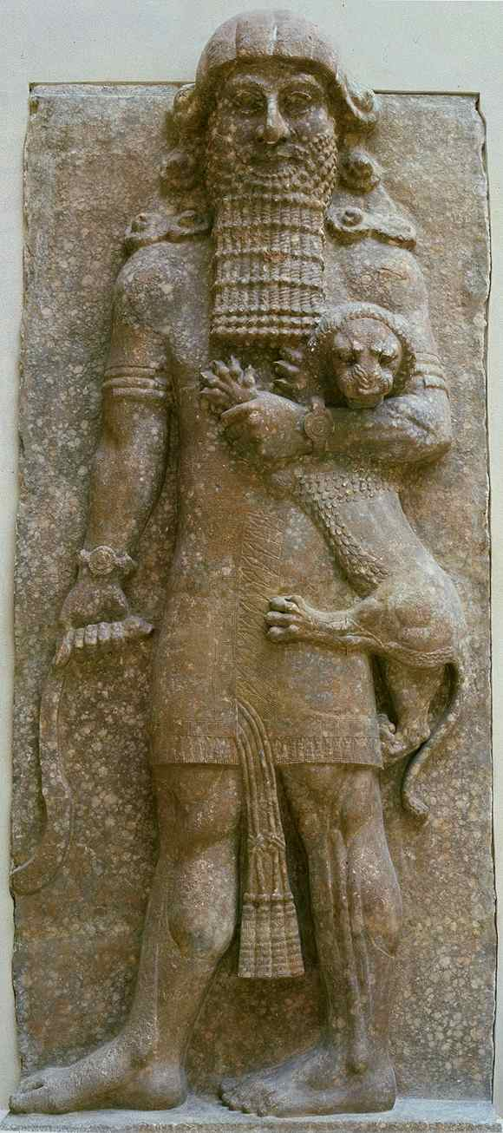
Gilgamesh
King of Uruk

Slide 4
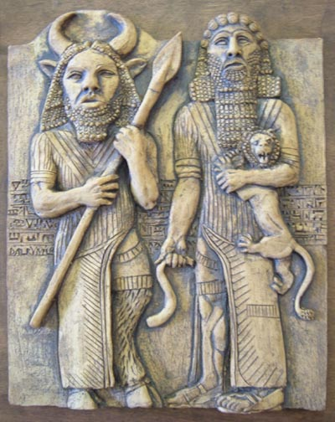
Gilgamesh and Enkidu

Slide 5
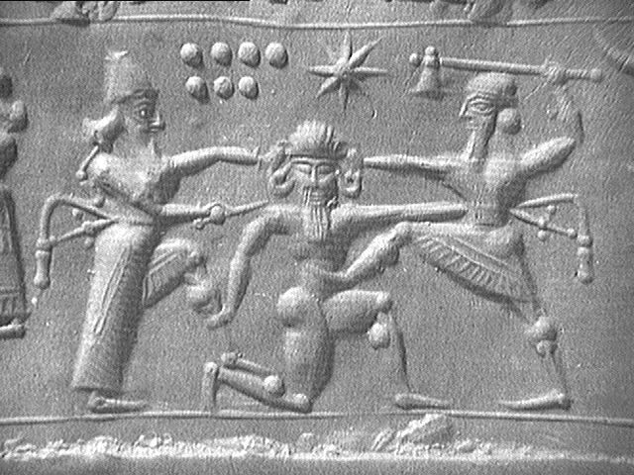

Slide 6
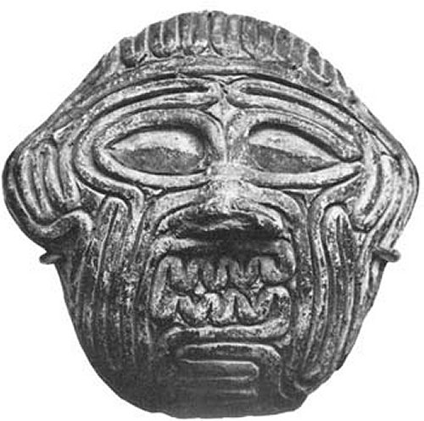
Humbaba
Clay mask made to look like wound up intestines.

Slide 7
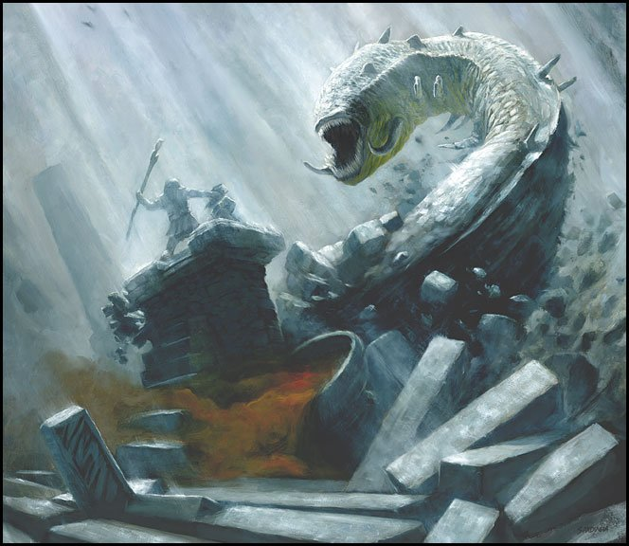

Slide 8
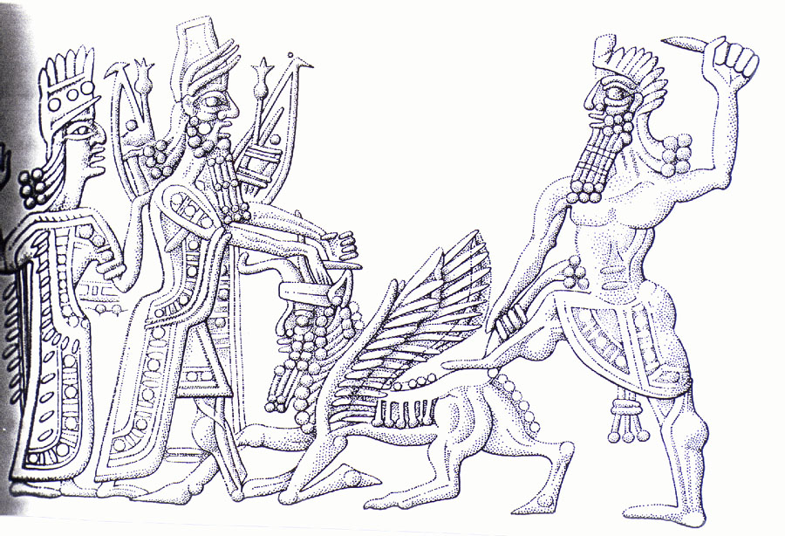
Gilgamesh and Enkidu kill the bull of heaven

Slide 9
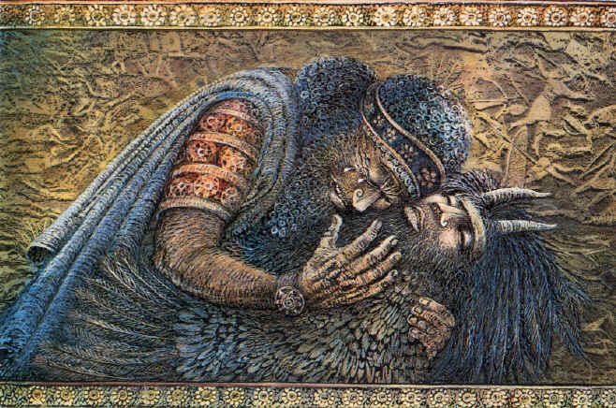
Death of Enkidu

Slide 10
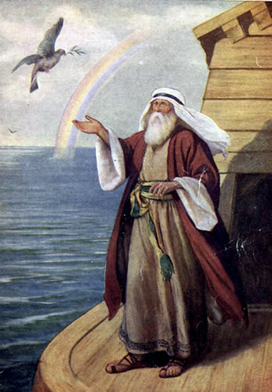
Utnapishtim
Looking for immortality.
Finds Utnapishtim who survived the flood.
This part of the story matches Noah and the flood.

Slide 11
